Slide 1
Evaluating Crash Characteristics and Safety Outcomes at Roundabouts: Implications for Safer Intersections
by
Rohit Chakraborty
Thesis Committee
Chair of the Committee: Dr. Subasish Das, Assistant Professor
Committee Member: Dr. Feng Hong, Associate Professor of Practice
Committee Member: Dr. F. Benjamin Zhan, Professor
June 25, 2025

Slide 2
Outline
Background
Problem statement
Literature review
Data description
Methodology
Results and Discussion
Conclusion

Slide 3
Background

Slide 4
What is a roundabout?
A roundabout is a circular intersection where traffic flows counterclockwise (in U.S.) around a central island, with entering vehicles yielding to those already inside (Li et al., 2024).
Vehicles entering from various legs need to slow down and operate at a lesser speed as the path of travel gets deflected.
Roundabouts could be of different types.

Slide 5
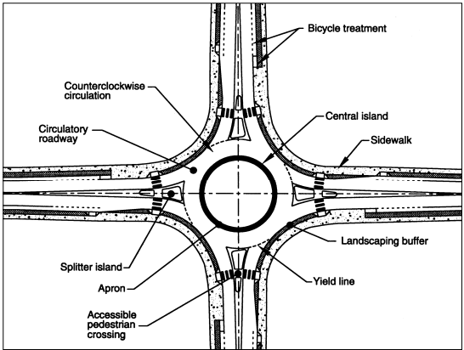
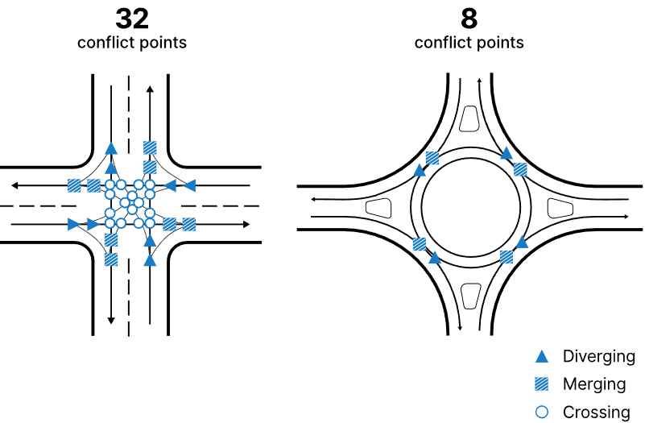
What is a roundabout?
Schematic diagram
Conflict points

Slide 6
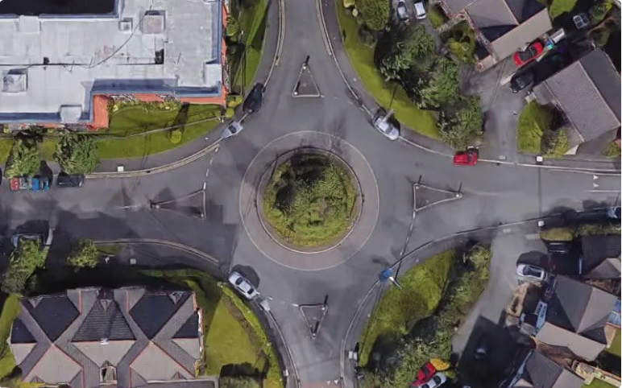
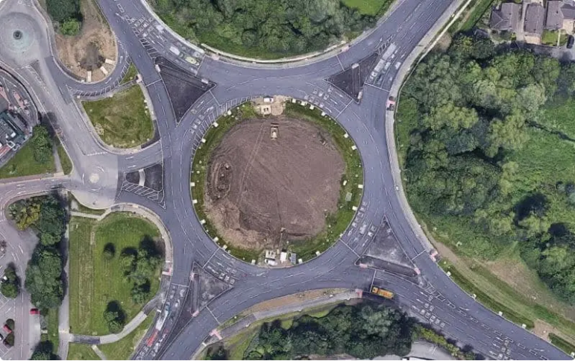
Types of roundabout
Single-lane roundabouts
Multi-lane roundabouts
Image source: https://www.passmefast.co.uk/resources/driving-advice-and-safety/driving-well/roundabout-types
Notes:
Multi-lane roundabouts can increase number of conflict points to up to 24.

Slide 7
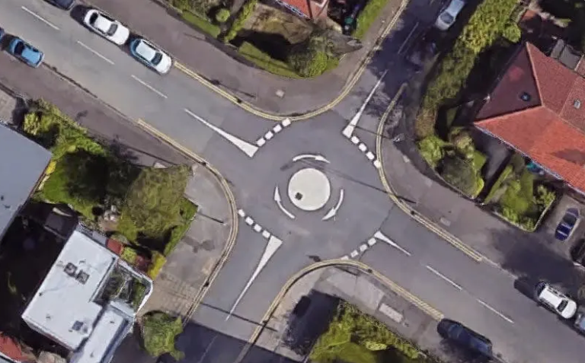
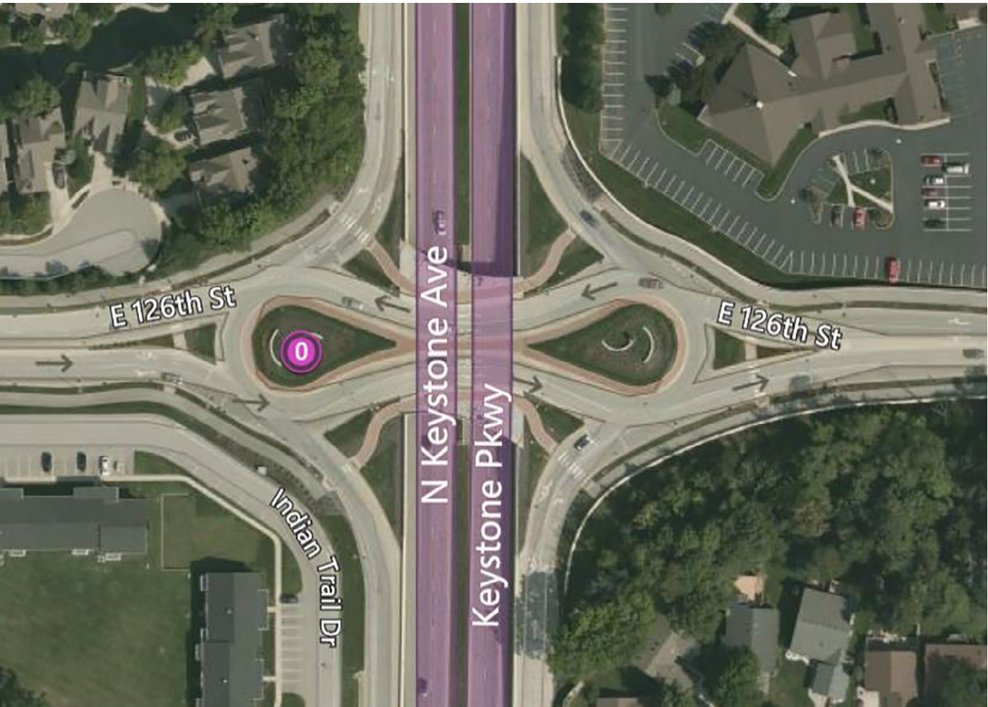
Types of roundabout
Mini roundabouts
Double-teardrop roundabout
Image source: https://www.passmefast.co.uk/resources/driving-advice-and-safety/driving-well/roundabout-types
Notes:
Trucks/larger vehicles may need to Passover the central island.
Also known as a "dogbone" interchange, is a designed to improve traffic flow and safety, particularly at intersections where a surface road meets a high-speed through traffic. It essentially combines two teardrop-shaped roundabouts connected by a section of road, resembling a dog bone.

Slide 8
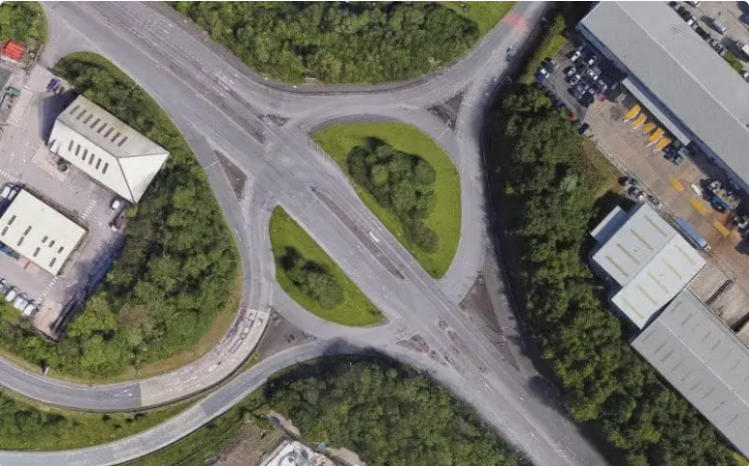
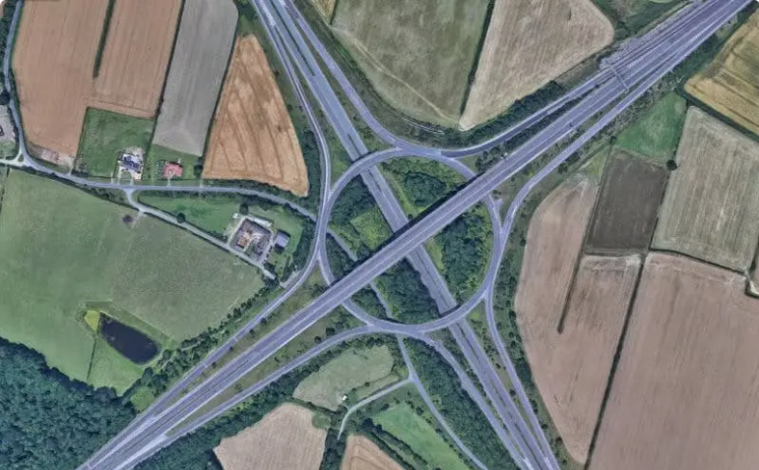
Types of roundabout
Cut-through roundabouts
Roundabout interchanges
Image source: https://www.passmefast.co.uk/resources/driving-advice-and-safety/driving-well/roundabout-types
Notes:
To prioritize through vehicles with higher speed, some other types of roundabouts are also designed.
Cut-through roundabouts, also known as 'throughabouts’, combine a roundabout with a straight road.
A roundabout interchange is a type of freeway interchange where ramps connect to a central roundabout instead of traditional signalized intersections.

Slide 9
Problem Statement

Slide 10
It is safer
Roundabouts are considered a safe countermeasure to reduce crashes compared to other at-grade intersections (Maji and Ghosh, 2025).
This design reduces speeds and collision points, making roundabouts safer and more efficient than traditional intersections.
Overall reduction in fatalities was recorded in several studies (Savolainen et al., 2023; Maji and Ghosh, 2025; Li et al., 2024).

Slide 11
Then what’s the problem?
Recent studies showed that roundabouts on average tended to have 58% more crashes (mostly less severe and no injury crashes) than conventional intersections (Savolainen et al., 2023).
Crash modification factor (CMFs) of 1.58 was found after implementing roundabouts. It indicates 58% increase in crashes. However, FI (fatal/injury) crashes decreased, and non-FI crashes increased.
Multi-lane designs can increase confusion about lane choice, merging, and exiting (Johnson, 2019).

Slide 12
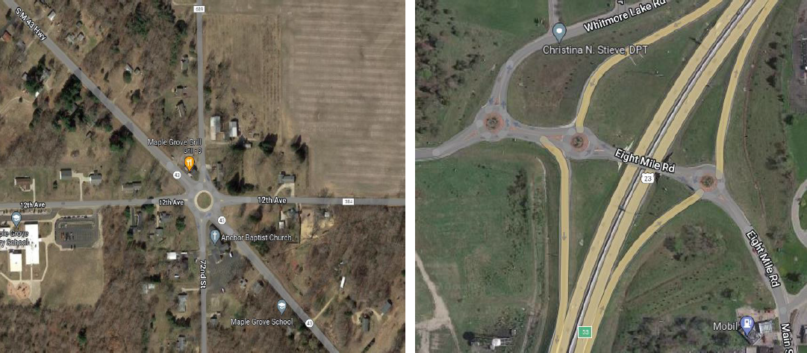
Then what’s the problem?
Geometric design, unsuitable control over traffic flows can influence roundabout safety (Robinson et al., 2000).

Slide 13
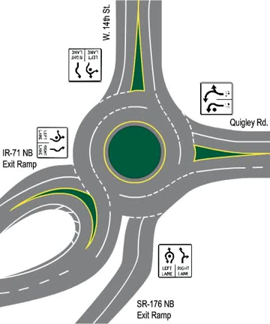
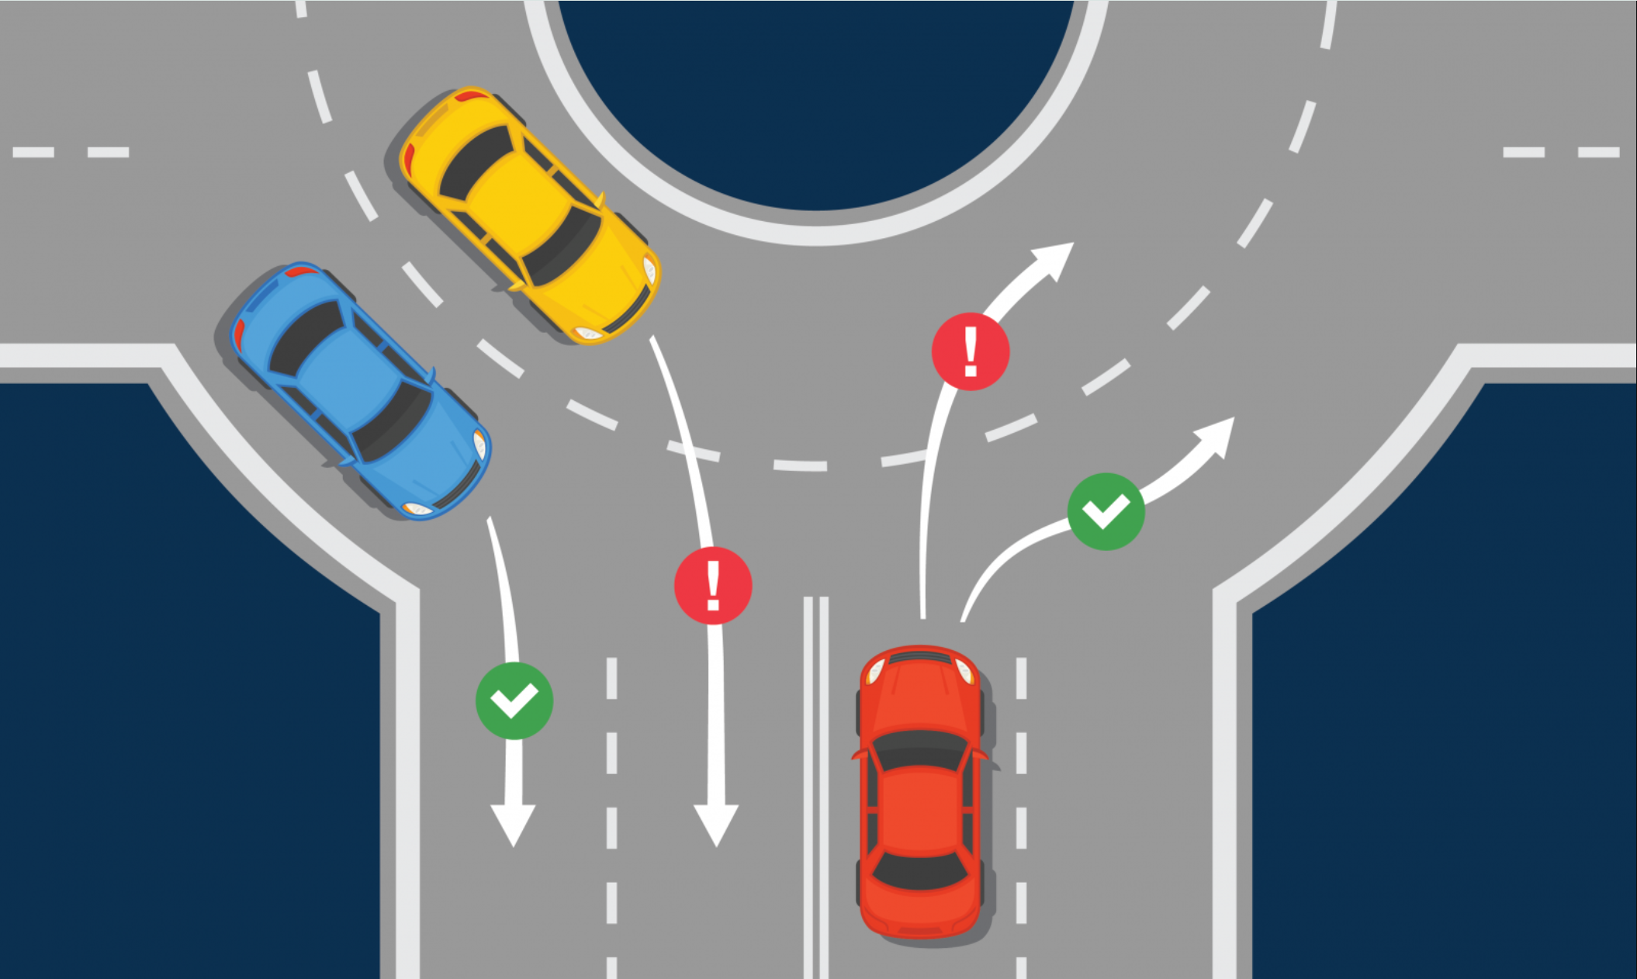
Then what’s the problem?
Improper actions.
Notes:
Improper actions such as speeding, unauthorized lane change, tailgating, aggressive driving etc. can significantly increase the injury severity rate

Slide 14
Research questions?
RQ1: If roundabouts are generally considered the safest intersection design, what factors are contributing to different types of injuries when crashes occur?
RQ2: What distinct clusters or patterns of crash characteristics can be identified within roundabout-related crashes, and how do these clusters relate to injury severity?
RQ3: What specific design features or configurations of roundabouts are most closely linked to high-severity crashes?

Slide 15
Literature Review

Slide 16
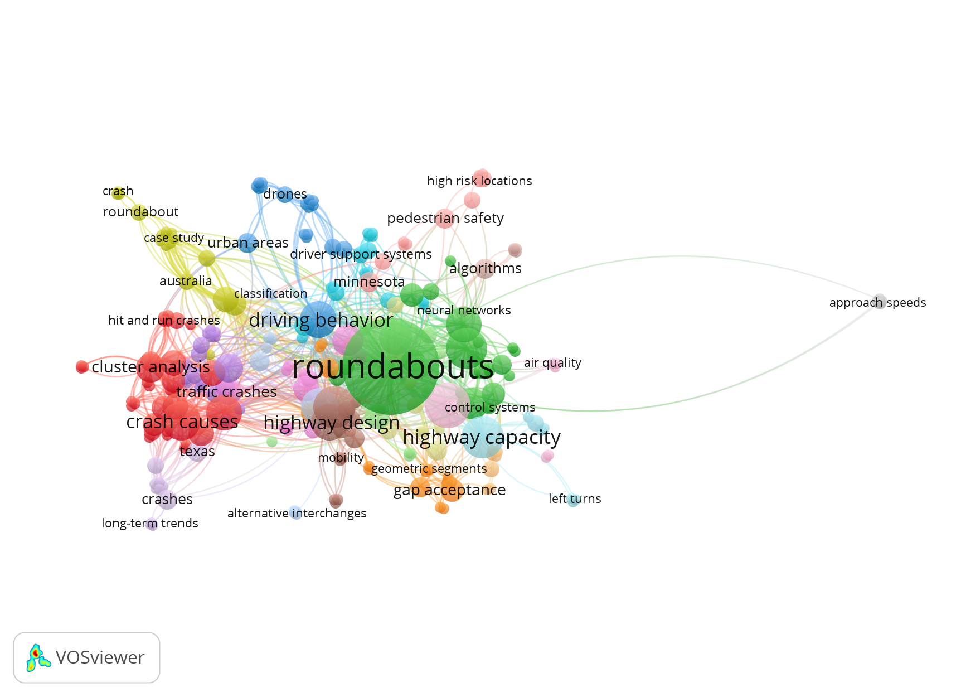
Keyword co-occurrence network

Slide 17
Review of previous studies
Maji and Ghosh (2025) noted that multi-lane roundabouts are often linked to increased property-damage-only crashes due to confusing lane assignments and poor signage.
Vinayaraj and Perumal (2023) identified over 11,000 roundabout-related crashes in one year, citing driver non-compliance, high speeds, and complex geometrics as key contributing factors in urban roundabouts.
Novat et al. (2024) observed that slip lanes at roundabouts increase vehicle speeds and pedestrian conflict risks.
Notes:
One study found that multi-lane roundabouts often experience a higher number of property-damage-only crashes. This is largely due to confusing lane assignments and poor signage, which make it harder for drivers to navigate properly.
Another study reported over 11,000 roundabout-related crashes in a single year, emphasizing issues like driver non-compliance, excessive speeds, and complex roundabout geometry, especially in busy urban areas.
Lastly, research has shown that slip lanes, while improving vehicle flow, can actually increase vehicle speeds and raise the risk of pedestrian conflicts, especially in locations with significant foot traffic.

Slide 18
Review of previous studies
Singleton et al. (2024) found that most cyclists feel unsafe navigating roundabouts, particularly multi-lane designs.
Savolainen et al. (2023) reported that drivers often fail to yield to circulating vehicles and pedestrians, especially in high-speed or freeway-adjacent roundabouts, leading to increased entry and crossing conflicts.
Polders et al. (2015) found that a large portion of roundabout crashes in Belgium involved entry collisions, often under conditions of poor visibility or misleading geometric cues, highlighting design limitations.
Notes:
Studies also showed that many cyclists feel unsafe when navigating roundabouts—especially those with multi-lane designs, where vehicle interactions become more complex.
Several studies pointed out that drivers frequently fail to yield to circulating vehicles or pedestrians, particularly in high-speed or freeway-adjacent roundabouts, leading to frequent entry and crossing conflicts.
Finally, it’s been found that a large share of roundabout crashes involve entry collisions, often under conditions of poor visibility or misleading geometry, emphasizing design-related shortcomings that affect driver judgment and reaction time.

Slide 19
Research gaps
Gap remains in investigating crash characteristics, person behavior, roadway and environmental factors to examine the roundabout crashes.
Most previous studies use regression-based or aggregated models that may miss complex interactions among crash variables
Limited use of clustering techniques like Cluster Correspondence Analysis (CCA) to uncover hidden patterns in roundabout crashes.
Few studies integrate explainable machine learning approaches such as SHAP to interpret variable influence on crash severity.
Notes:
First, there's still a major gap in examining crash characteristics, driver behavior, roadway, and environmental factors together when studying roundabout crashes.
Second, most existing studies rely on regression-based or aggregated models, which can miss complex interactions among variables and overlook nuanced crash patterns.
Third, there has been limited use of clustering methods, especially techniques like Cluster Correspondence Analysis, which are well-suited for identifying hidden crash scenarios based on categorical data.
Only a few studies have incorporated explainable machine learning, such as SHAP, to interpret which variables actually drive crash severity—an approach we applied in this study to bridge that gap.

Slide 20
Research gaps
Crash narratives are often overlooked in severity analysis, missing real-world behavioral and contextual insights.
Prior research has not adequately linked crash patterns with roadway features like entry design, number of lanes, or traffic control types.
The combined impact of environmental, geometric, and behavioral factors on injury severity within roundabouts remains insufficiently addressed.
Notes:
Crash narratives are often overlooked in severity analysis. This means we miss important behavioral and contextual insights that explain how and why severe crashes happen.
Previous studies have not adequately linked crash patterns to roadway features, such as entry design, number of lanes, or traffic control types—factors that are critical to roundabout safety.
Finally, the combined effect of environmental, geometric, and behavioral factors on injury severity has not been fully explored, leaving a gap in understanding how these elements interact within roundabout crashes.

Slide 21
Data Description

Slide 22
Study location
The dataset includes five years (2017-2021) of roundabout crash data from Ohio.
6,448 crashes that include Fatal/Severe injury crashes, Moderate/Minor injury crashes, and Property damage crashes.
Variables that represent geometric data, vehicle characteristics, crash characteristics, roadway and environmental conditions were considered.

Slide 23
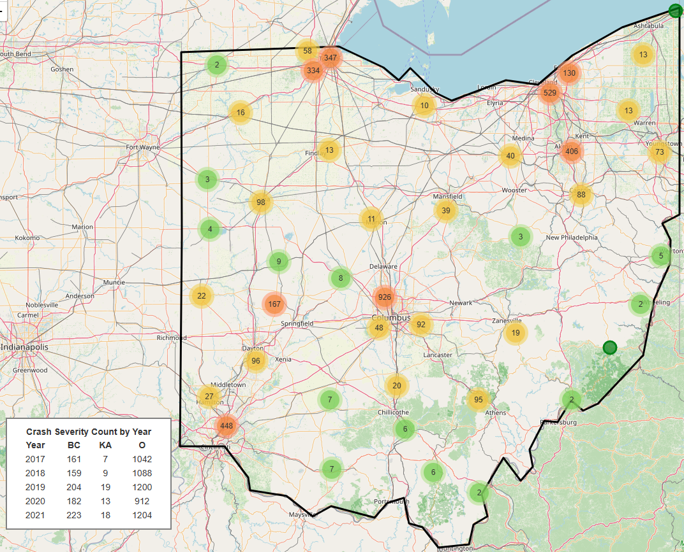
Crash distribution
Link: https://roundabout-crashes.vercel.app/

Slide 24
Methodology

Slide 25
Study design
CCA
Clustering
4 Clusters
Clusters
KA, BC, O
Interpretation
SHAP
12 plots
Narrative analysis
Crash narrative data
Spatial analysis
Hot-spot analysis
*Injury severity: KA – Fatal/Severe, BC – Moderate/Minor, O – Property damage only

Slide 26
Cluster Correspondence Analysis (CCA)
A technique for identifying clusters of similar data points based on multiple categorical variables.
Correspondence Analysis (CA): Projects categorical data into a low-dimensional space based on associations between variable categories.
K-means Clustering: Groups observations into clusters based on their proximity in that space, revealing naturally occurring patterns.
Visualizes clusters on a two-dimensional plot, making it easier to interpret relationships.

Slide 27
SHapley Additive exPlanations (SHAP)
It explains how much each variable contributes to a model’s prediction for a specific outcome (e.g., crash severity).
Based on Shapley values from cooperative game theory, which fairly distribute a model’s prediction across input features.
Positive SHAP value → Feature increases the chance of a severe crash.
Negative SHAP value → Feature decreases that chance.
Allows individual-level and global-level interpretation of model outputs.
Notes:
SHAP is a method used to interpret how much each variable contributes to a model’s prediction. In my study, I used SHAP to understand what factors were influencing the predicted crash severity. It’s based on game theory, specifically Shapley values, which fairly distribute the contribution of each feature across the model’s decision (in this case XGBoost were used). A positive SHAP value means that a feature is pushing the prediction toward a more severe crash, while a negative value suggests it’s pulling the prediction toward a less severe outcome. The strength of SHAP is that it offers both global-level and individual-level interpretations, so we can see not only which features matter most overall, but also how they behave in specific clusters of crashes.

Slide 28
How are SHAP values calculated?
Each feature (e.g., vehicle type, lighting condition) is treated like a player in a game that contributes to the “payout” (the model’s predicted severity score).
SHAP calculates how the prediction changes when a feature is added or removed from all possible combinations of inputs.
The SHAP value for a feature is the average marginal contribution of that feature across all possible feature combinations.
Notes:
To understand how SHAP values are calculated, think of each feature, like vehicle type or lighting condition, as a player in a cooperative game. Each player contributes to the final payout, which in our case is the model’s predicted crash severity. SHAP works by computing how the prediction changes when we add or remove a feature from every possible combination of features. It then takes the average of those changes. So, the SHAP value for a feature reflects its average marginal contribution to the prediction. This approach ensures that each feature is evaluated fairly, regardless of the order in which features are considered.

Slide 29
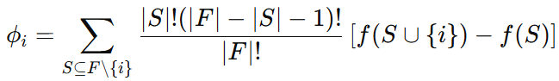
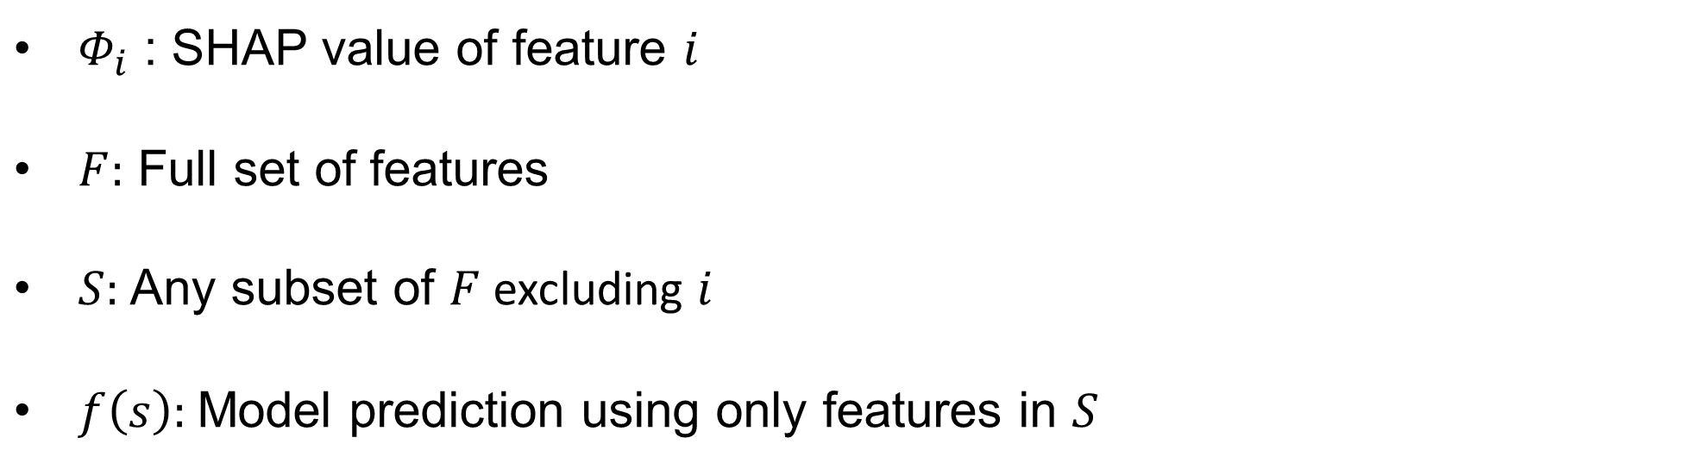
How are SHAP values calculated?
$Φ_{i}$ : SHAP value of feature $i$
$F:$ Full set of features
$S:$Any subset of $F$excluding $i$
$f\left(s\right):$Model prediction using only features in $S$

Slide 30
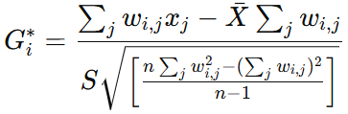
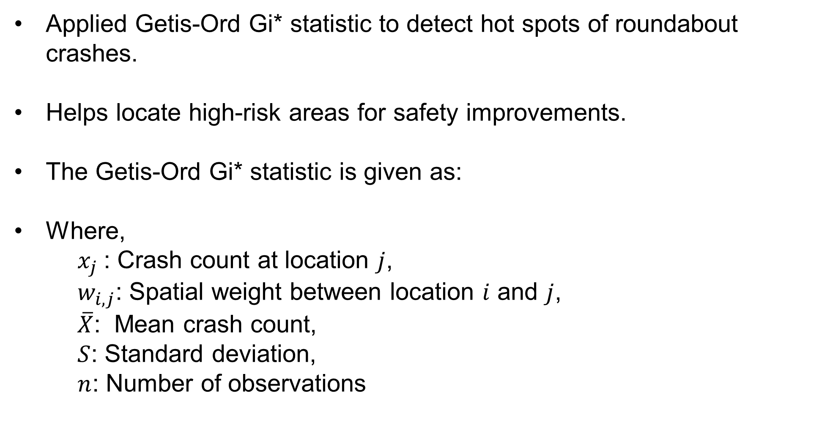
Spatial analysis
Applied Getis-Ord Gi* statistic to detect hot spots of roundabout crashes.
Helps locate high-risk areas for safety improvements.
The Getis-Ord Gi* statistic is given as:
Where,
$x_{j}$: Crash count at location $j$,
$w_{i,j}$: Spatial weight between location $i$ and $j$,
$\overline{X}$: Mean crash count,
$S$: Standard deviation,
$n$: Number of observations
Notes:
I used the Getis-Ord Gi* statistic to identify spatial clusters, specifically, to detect hot spots where roundabout crashes are unusually concentrated. This method evaluates each location in the context of its neighbors to determine whether high or low crash values are statistically significant. High positive Gi* values indicate hot spots, and significantly low values indicate cold spots.

Slide 31
Result and Discussion

Slide 32
Selected variables
Roundabout Crashes
XGBoost
Random Forest
Considered Variables
6,448 crashes
Top 17 variables:
U1 Unit type (Unt)
Crash type (Typ)
U1 Pre-crash action (Act)
U1 Contributing factor (Cnf)
Functional class (Fun)
Weather (Wth)
Lighting conditions (Lgh)
Traffic control device (Tcd)
Road contour (Cnt)
Posted speed limit (PSL)
Number of lanes (Ln)
Facility type (Fcl)
Gender (Gen)
Road condition (Cnd)
Young driver (Yng)
Roadway departure (Dep)
Day oof week (DOW)
Top 17 variables:
Crash type (Typ)
U1 Unit type (Unt)
U1 Contributing factor (Cnf)
Roadway departure (Dep)
U1 pre-crash action (Act)
Gender (Gen)
Road condition (Cnd)
Weather (Wth)
Lighting conditions (Lgh)
Number of lanes (Ln)
Facility type (Fcl)
Road contour (Cnt)
Posted speed limit (PSL)
Traffic control device (Tcd)
Young driver (Yng)
Functional class (Fun)
Day of week (DOW)
U1 Unit type (Unt)
Crash type (Typ)
U1 Contributing factor (Cnf)
U1 Pre-crash action (Act)
Weather (Wth)
Lighting conditions (Lgh)
Road condition (Cnd)
Traffic control device (Tcd)
Road contour (Cnt)
Posted Speed Limit (PSL)
Number of lanes (Ln)
Facility type (Fcl)
Young driver (Yng)
Severity (Sev)
21 variables
Removed variables over 85% skewed
18 variables
Variable Importance Analysis
Target variable - Severity

Slide 33
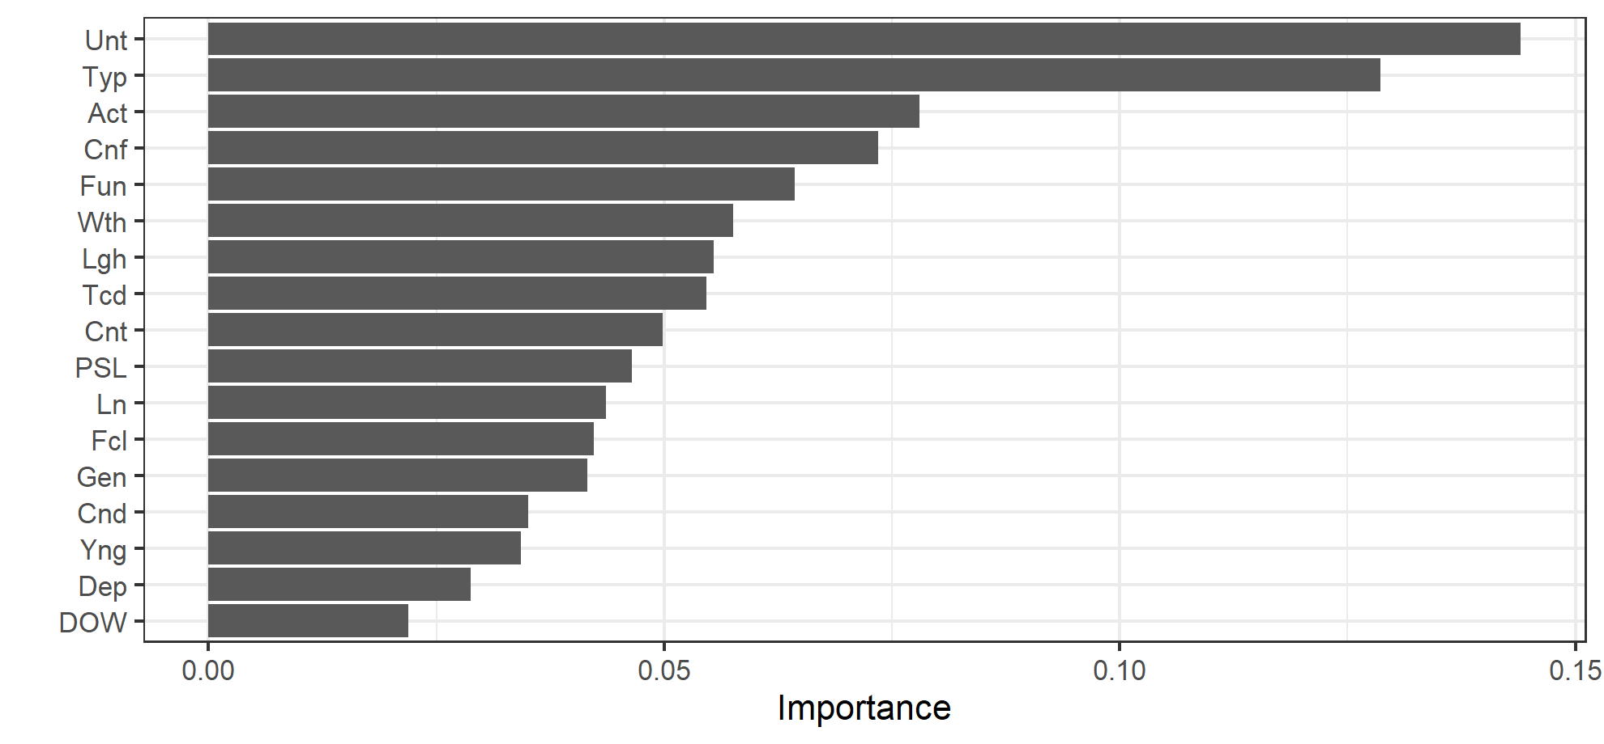
Variable importance analysis (XGBoost)

Slide 34
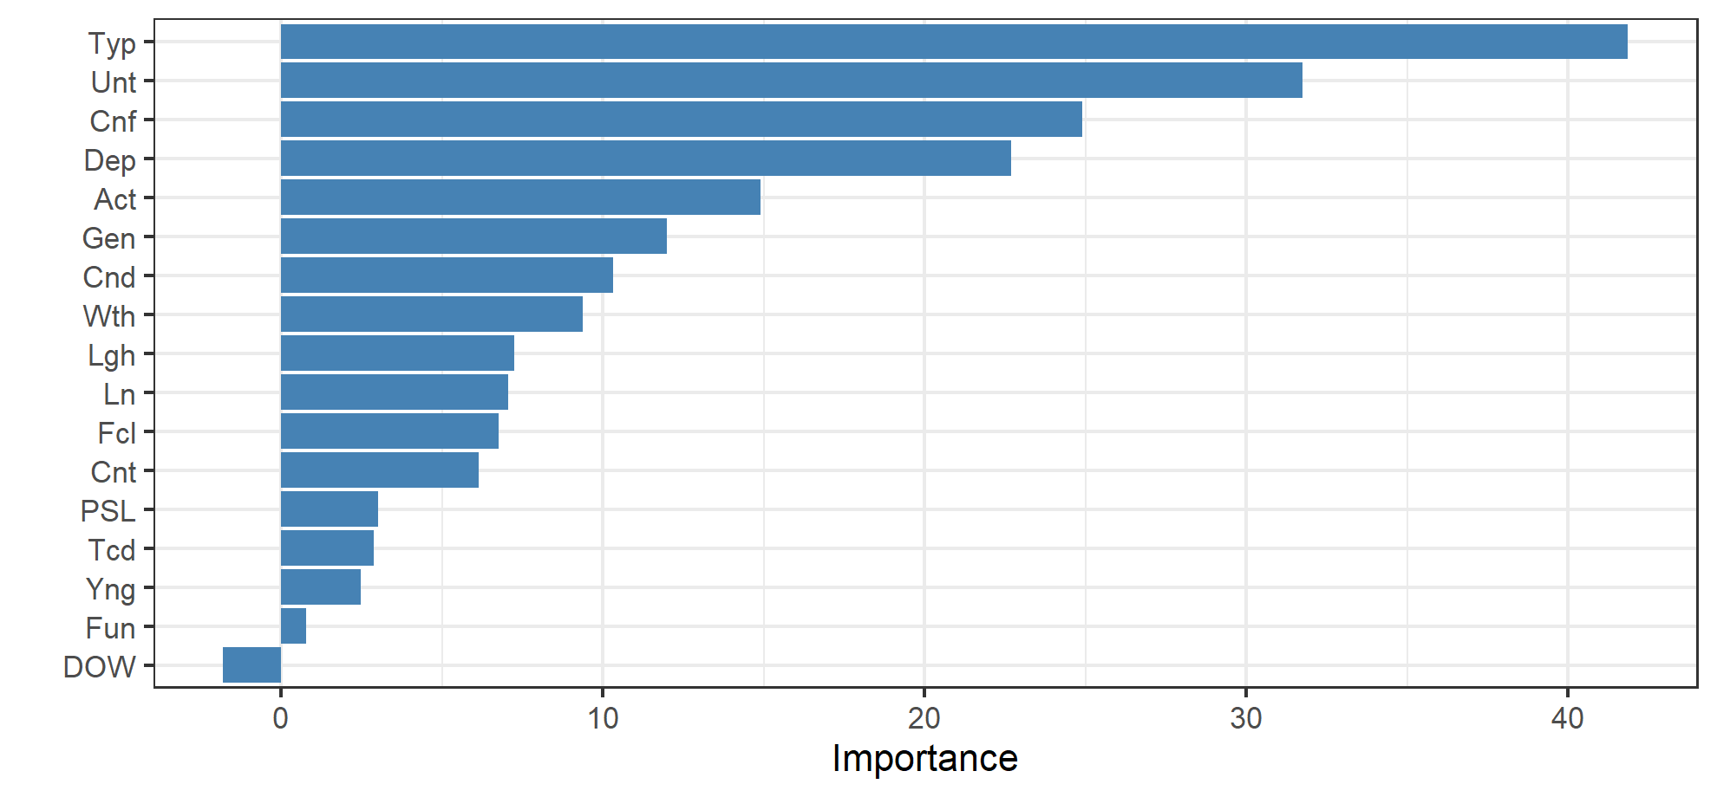
Variable importance analysis (RandomForest)

Slide 35
Developed clusters
Table: Centroid and size of clusters
Cluster | Roundabout Crash Clusters
 | Dim 1 | Dim 2 | Within cluster sum of squares | Size
Cluster 1 | -0.0096 | -0.0053 | 0.0424 | 2453
Cluster 2 | -0.0026 | 0.0036 | 0.0327 | 1396
Cluster 3 | 0.0048 | 0.0165 | 0.0396 | 1301
Cluster 4 | 0.0161 | -0.0103 | 0.0408 | 1298

Slide 36
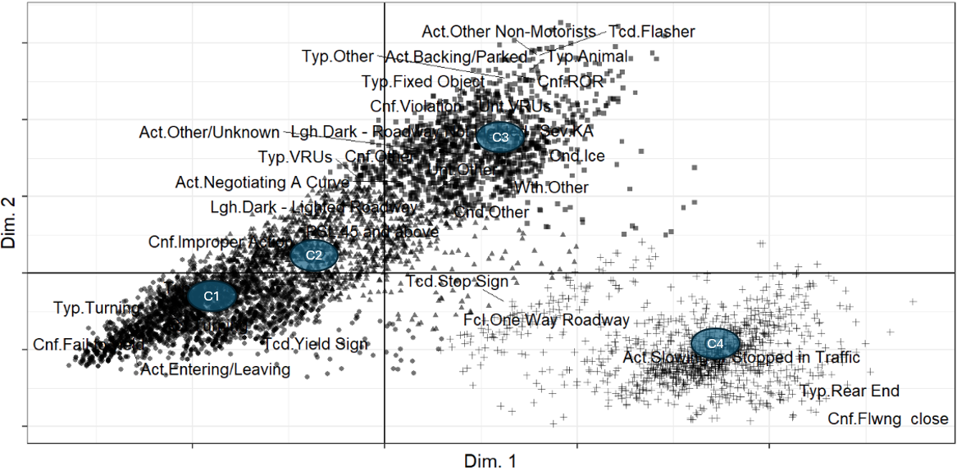
Developed clusters
Bi-plot of developed clusters

Slide 37
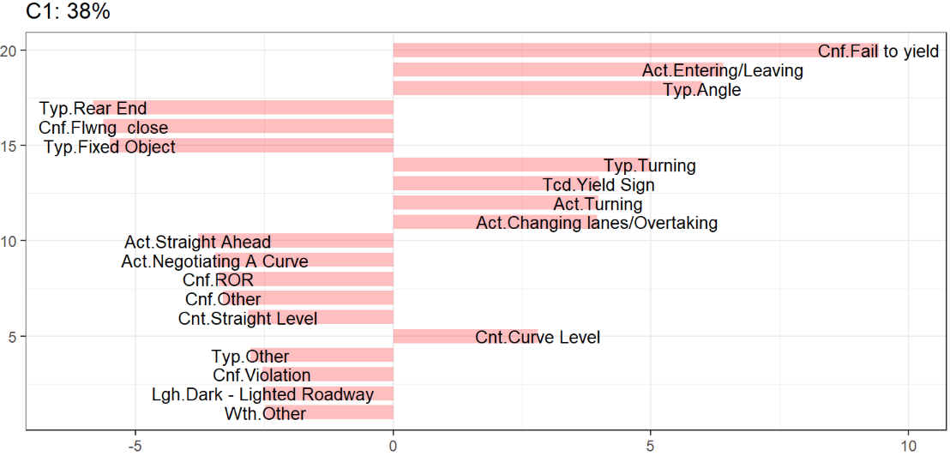
Developed clusters
Cluster 1: Entry and Yield-Related Conflicts

Slide 38
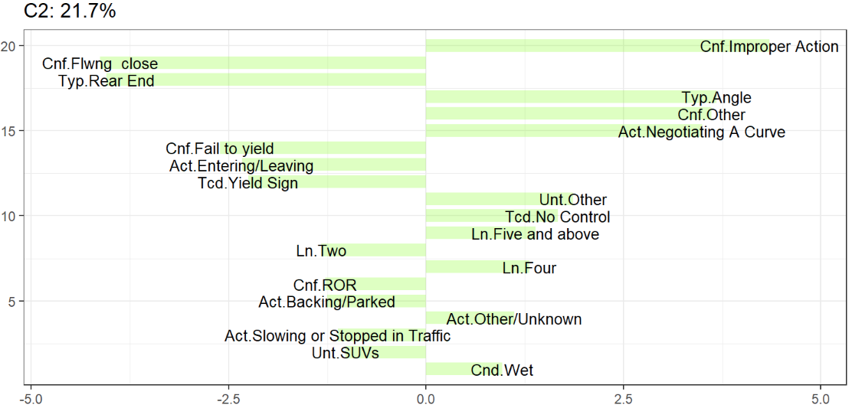
Developed clusters
Cluster 2: Improper Maneuvers and Driver Misjudgment Crashes

Slide 39
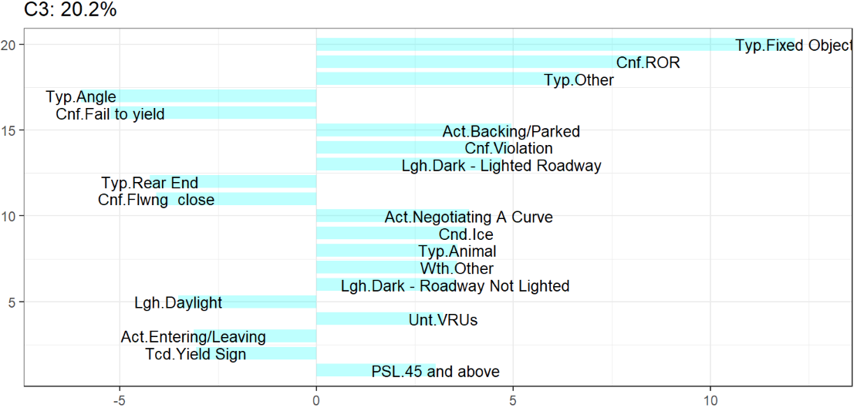
Developed clusters
Cluster 3: Fixed Object and Environmental Hazard Crashes

Slide 40
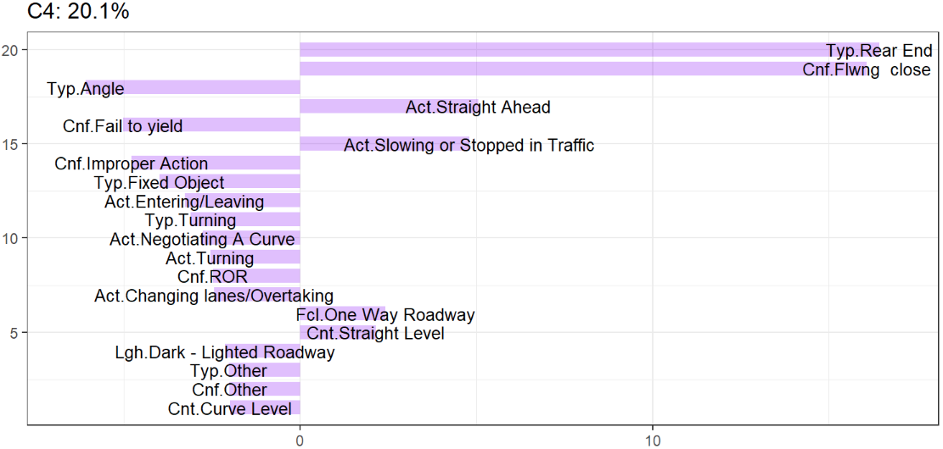
Developed clusters
Cluster 4: Rear-End and Following-Distance Crashes

Slide 41
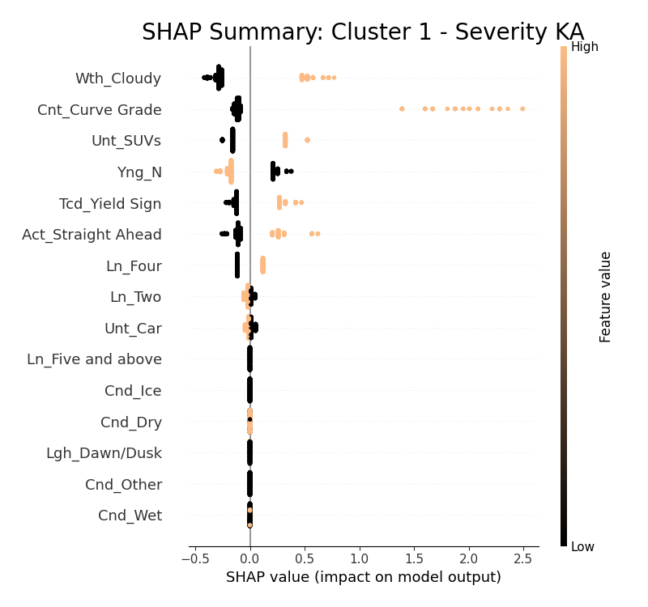
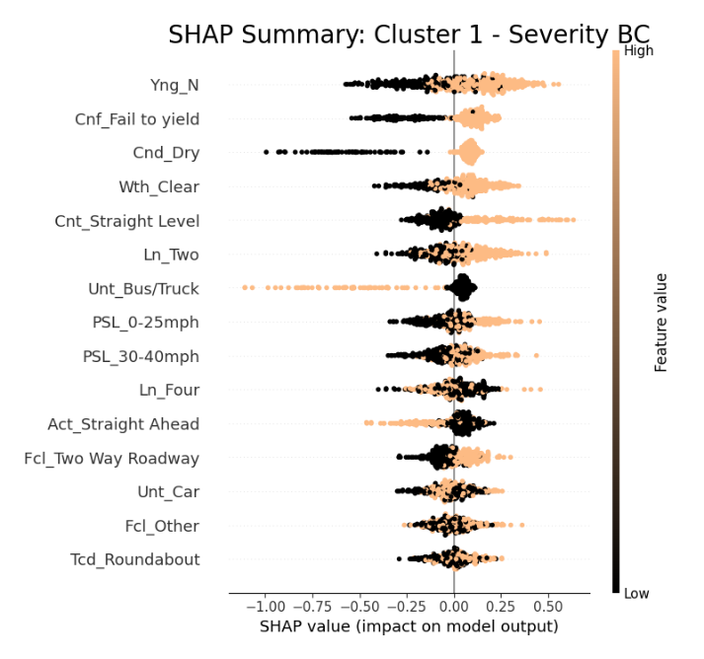
SHAP Interpretation
Cluster 1: Entry and Yield-Related Conflicts at Roundabouts
Fatal/Severe
Moderate/Minor
Notes:
1. The further to the right the dot appears, the more that feature pushed the model toward predicting higher severity.

Slide 42
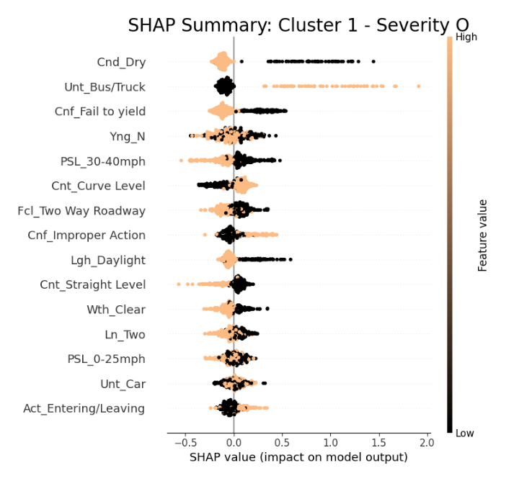
SHAP Interpretation
Cluster 1: Entry and Yield-Related Conflicts at Roundabouts
No Injury

Slide 43
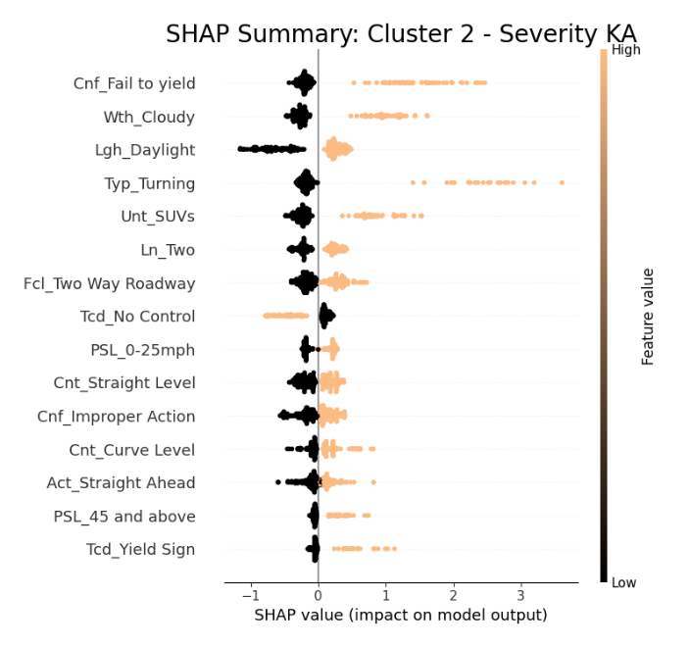
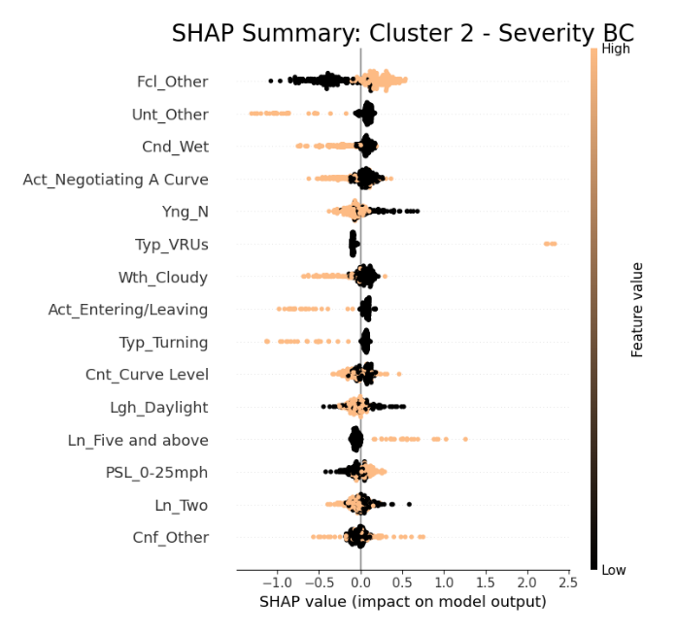
SHAP Interpretation
Cluster 2: Improper Maneuvers and Driver Misjudgment Crashes
Fatal/Severe
Moderate/Minor

Slide 44
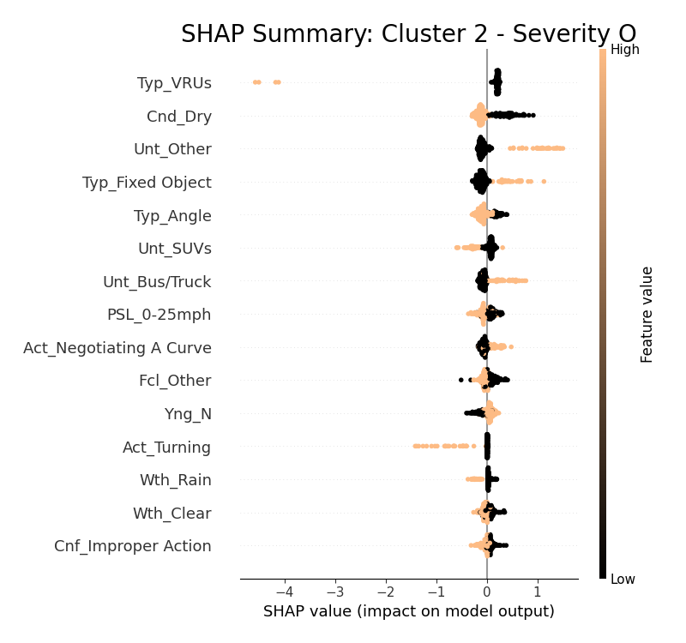
SHAP Interpretation
Cluster 2: Improper Maneuvers and Driver Misjudgment Crashes
No Injury

Slide 45
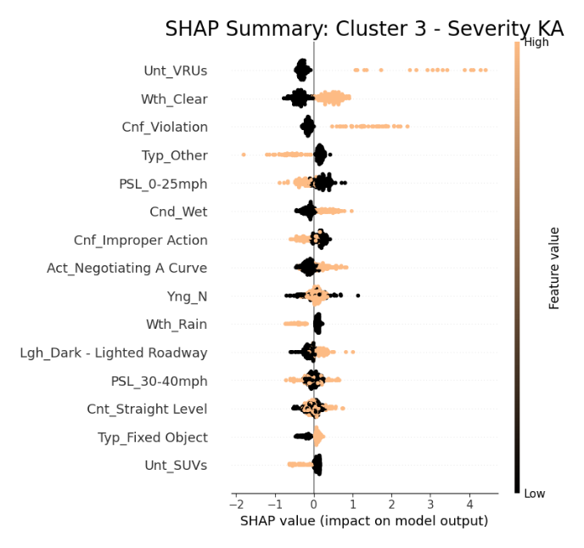
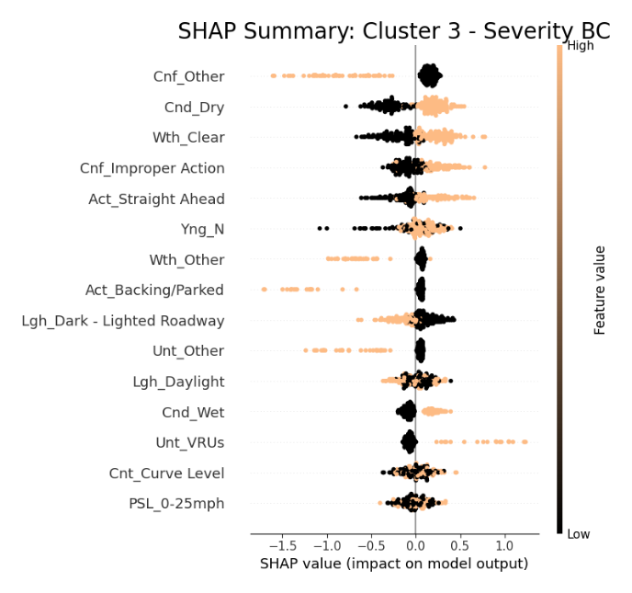
SHAP Interpretation
Cluster 3: Fixed Object and Environmental Hazard Crashes
Fatal/Severe
Moderate/Minor

Slide 46
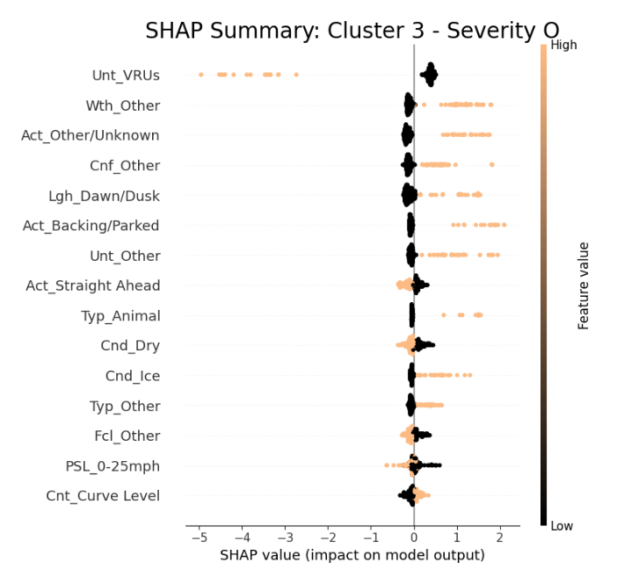
SHAP Interpretation
Cluster 3: Fixed Object and Environmental Hazard Crashes
No Injury

Slide 47
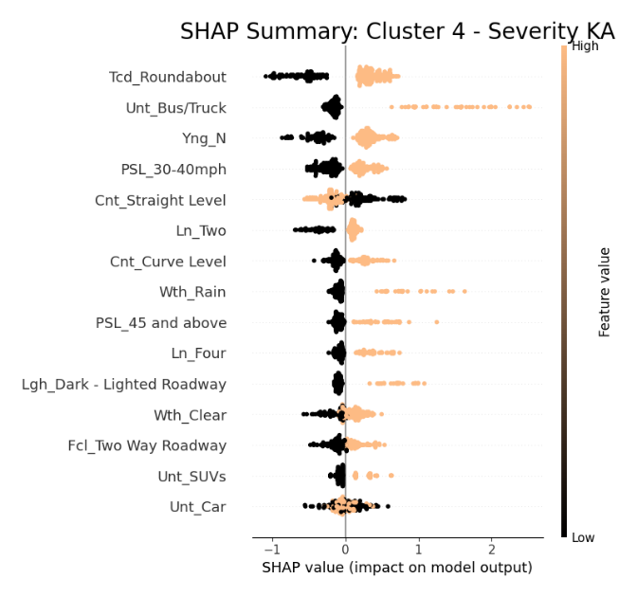
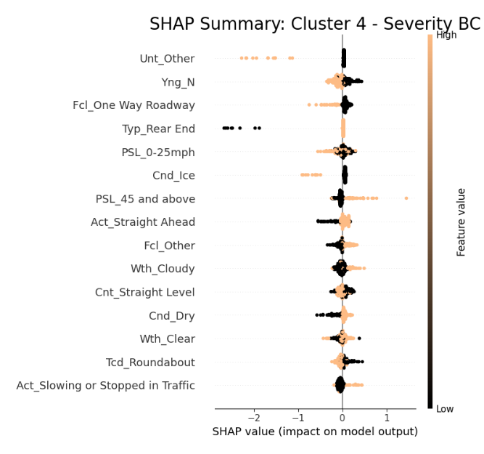
SHAP Interpretation
Cluster 4: Rear-End and Following-Distance Crashes
Fatal/Severe
Moderate/Minor

Slide 48
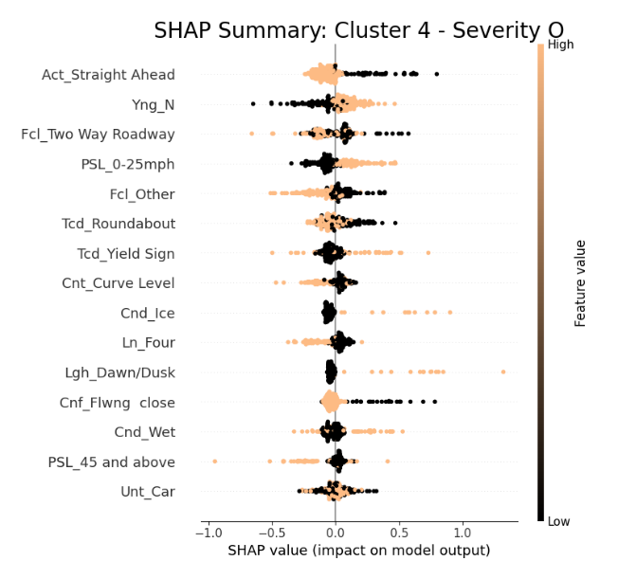
SHAP Interpretation
Cluster 4: Rear-End and Following-Distance Crashes
No Injury

Slide 49
Crash narratives: Fatal/Severe Crashes
Damage | Severity | Crash Type | Fault | Crash Narrative Summary
Not Specified | KA | ROR/Rollover | Unspecified/Unknown | Unit #1 was westbound on SR-0261 when it struck the curb at the roundabout, lost control, and rolled over. Serious injuries were reported.
Side | KA | Fixed Object | Failed To Yield | Unit #1 was traveling east on State Route 29. Unit #2 failed to yield and entered the roundabout, causing Unit #1 to veer off and hit a light pole.
Side | KA | Other | Failed To Yield | Unit 2 was inside the roundabout at the intersection when Unit 1 entered without yielding, striking Unit 2 in the passenger side and causing severe injury.
Notes:
This slide summarizes a few real-world examples of fatal or severe crashes at roundabouts to provide deeper context.
The first case involved a run-off-road rollover crash. The driver struck the curb while entering the roundabout, lost control, and rolled over—resulting in serious injuries. The exact cause was not specified, but the geometry and speed likely played a role.
The second case was a fixed-object crash where one vehicle failed to yield and entered the roundabout, causing another vehicle to veer off and strike a light pole. This highlights how failing to yield can lead to severe outcomes even without vehicle-to-vehicle contact.
In the third case, a vehicle already circulating in the roundabout was struck on the passenger side by another vehicle that entered without yielding. This side-impact crash led to a severe injury, emphasizing how entry violations remain a critical issue.
These narratives reinforce our earlier findings—particularly that failure to yield and poor control at entry are major contributors to high-severity roundabout crashes.

Slide 50
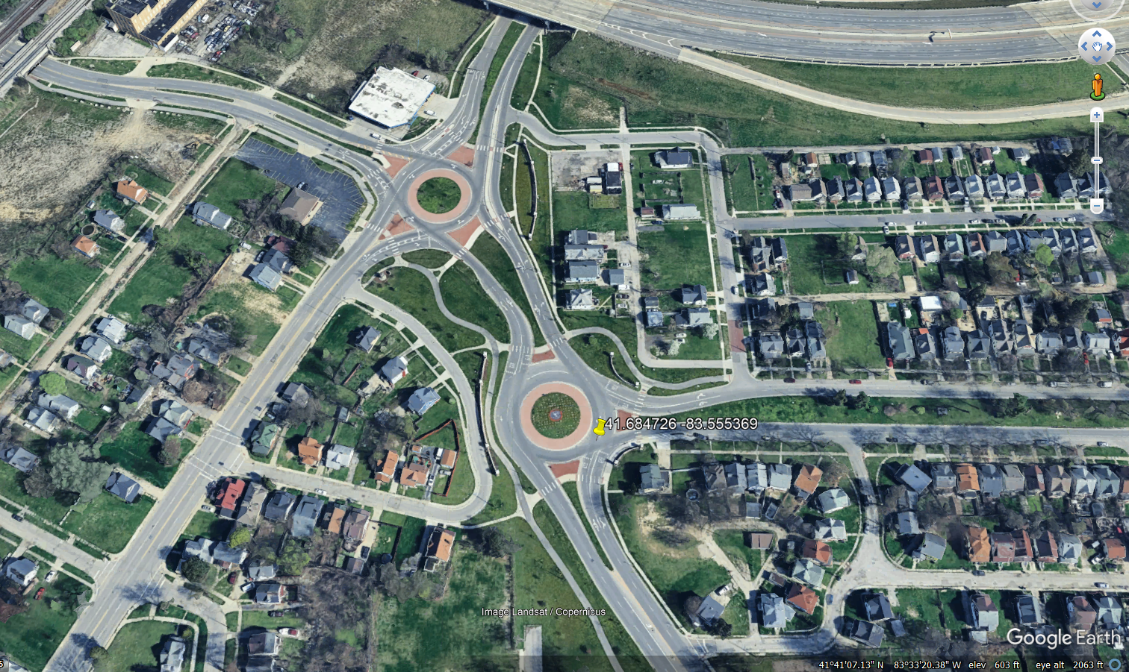
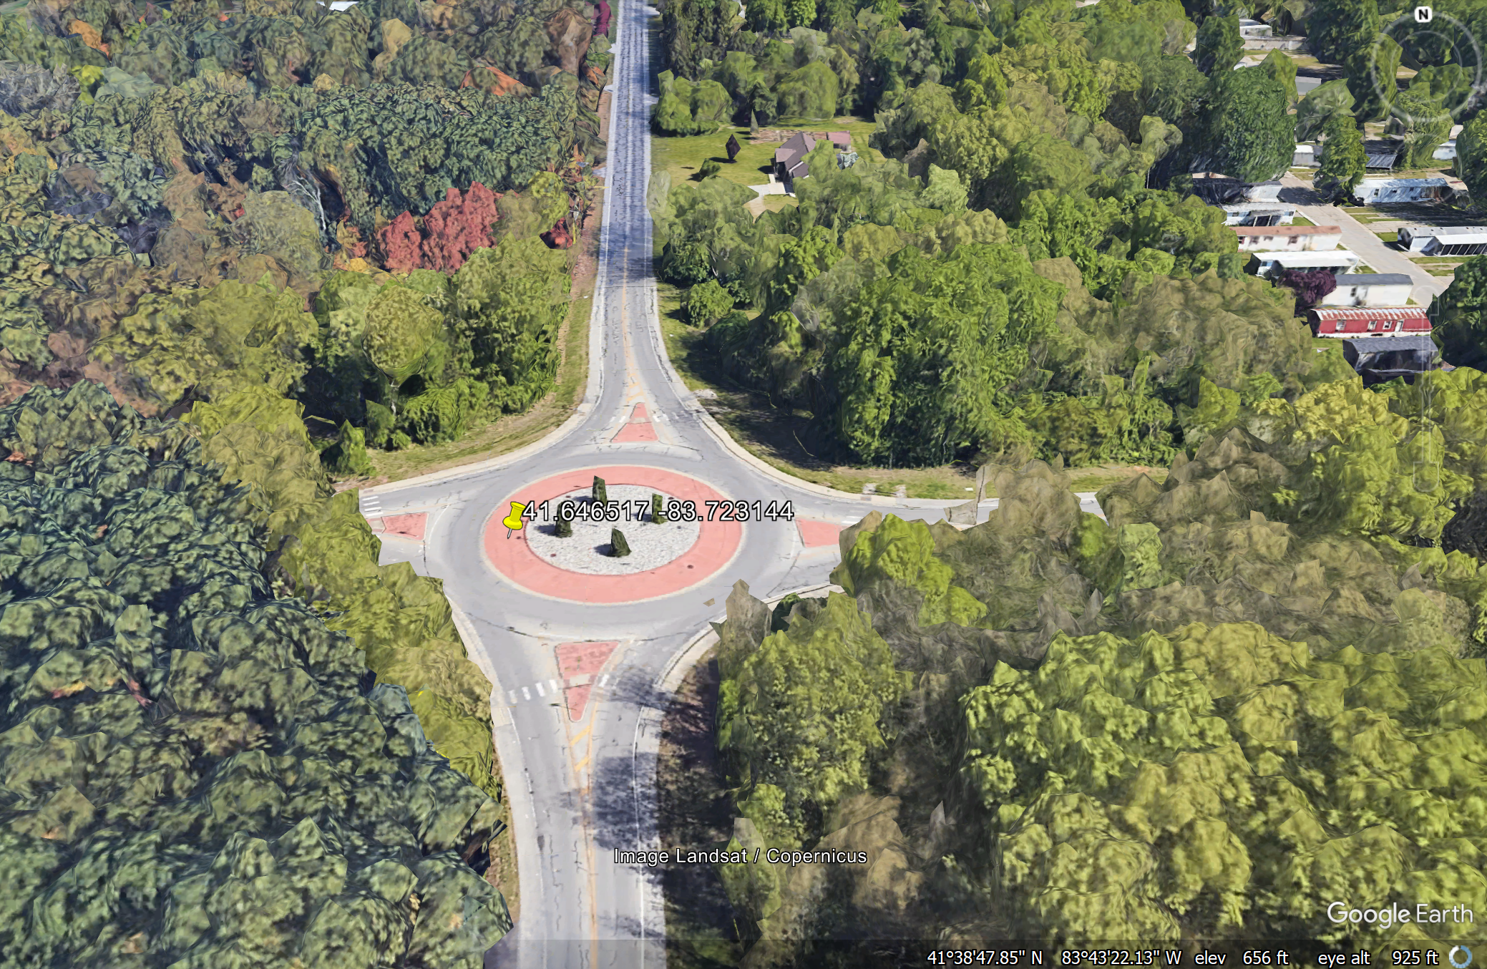
Design related factors
Design complexity.
Visibility and roadway lighting.

Slide 51
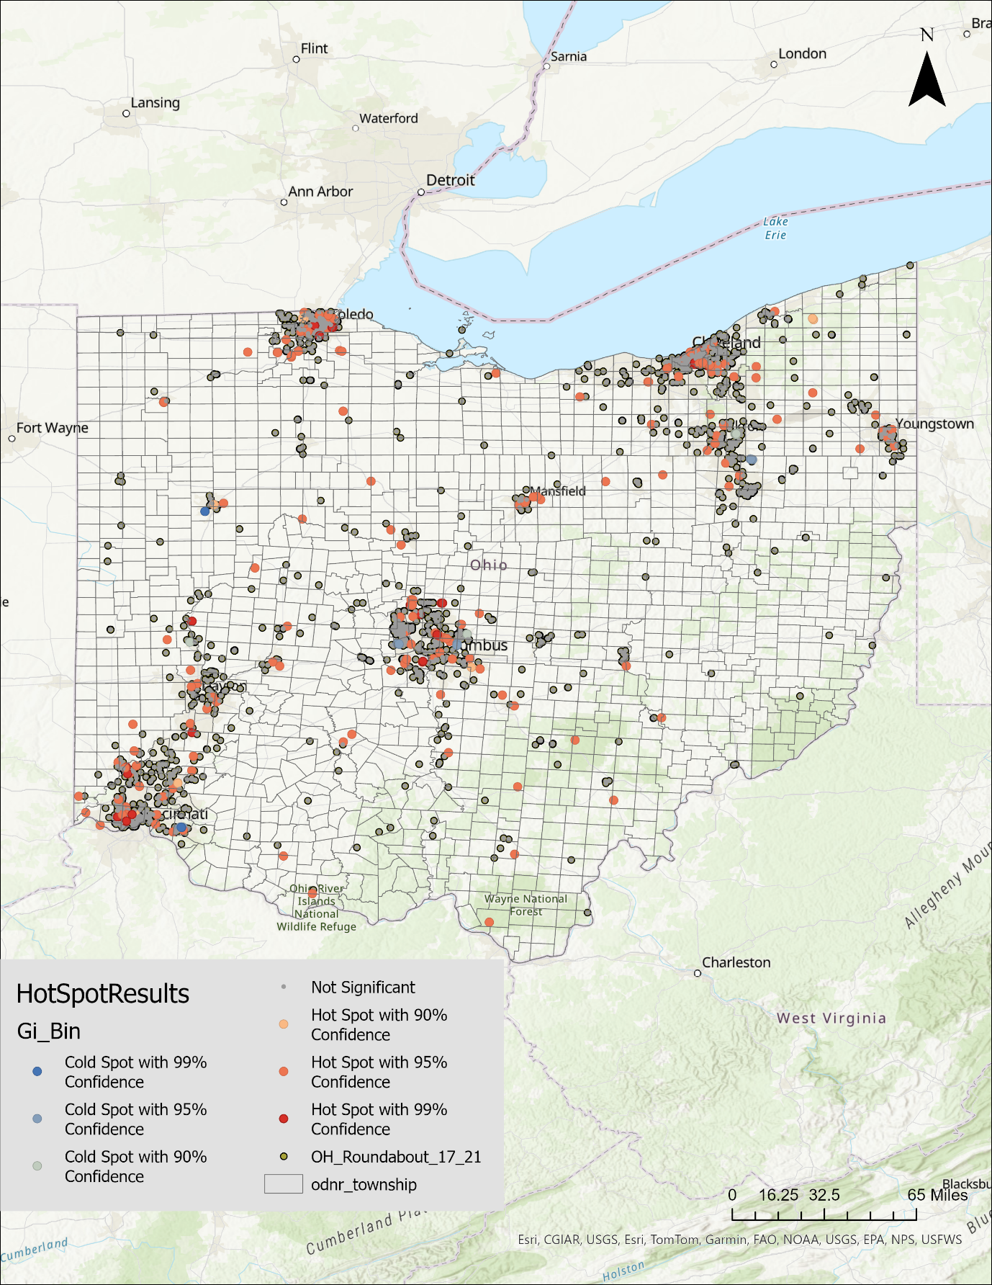
Hot spot analysis
Cincinnati, Columbus, Toledo, and Cleveland indicated higher concentrations of roundabout crashes.
Cold spots appeared in some parts of central and southeastern Ohio, typically in rural or low-traffic areas.

Slide 52
Conclusions

Slide 53
Major findings
RQ1: SHAP plots showed that failure to yield, improper actions, vehicle type (SUVs, buses, trucks), driver age group, pre-crash behavior, lighting and weather conditions, and speed limits significantly contributed to crash severity.
RQ2: The CCA grouped 6,448 roundabout crashes into four distinct clusters focused on entry conflicts, driver misjudgment, fixed-object / environmental crashes, and rear-end collisions.
RQ3: The analysis revealed that poor visibility/sight distance, wet or icy roads, and multi-lane or curved road geometries were strongly associated with more severe outcomes.

Slide 54
Major findings
Crash narratives added valuable context, confirming that many fatal and severe crashes involved loss of control, speeding, or failure to yield, and often resulted in fixed-object impacts or rollovers.
Hotspot analysis identified high-crash concentration areas in Cincinnati, Columbus, Toledo, and Cleveland, indicating urban-specific roundabout safety concerns.
The combined use of clustering, model interpretation, narrative review, and spatial analysis provided a comprehensive understanding of roundabout crash severity and risk patterns.

Slide 55
Policy recommendations
Improving entry design and yield controls (e.g., tighter curvature, splitter islands, visible signage).
Enhancing lane-use guidance in multi-lane roundabouts (e.g., overhead signs, pavement markings).
Upgrading lighting and visibility at roundabouts, especially in suburban/rural areas.
Using advisory speed plaques and feedback signs to reduce entry speed.
Notes:
This slide outlines several key policy recommendations based on the findings from my analysis of roundabout crashes in Ohio.
First, we recommend improving entry design and yield controls. Many crashes—especially severe ones—were linked to improper entries and failure to yield. Physical improvements such as tighter entry curvature, splitter islands, and highly visible signage can slow vehicles down and reinforce right-of-way behavior.
Second, in multi-lane roundabouts, we identified confusion and improper maneuvers as major crash contributors. To address this, we suggest enhancing lane-use guidance—this includes using overhead signs and pavement markings to help drivers select and stay in the correct lane.
Third, we found that poor lighting and visibility—particularly in rural and suburban areas—played a role in many severe crashes, including those involving fixed objects and vulnerable road users. So, we recommend upgrading lighting infrastructure, especially at night-prone and high-speed locations.
Next, to reduce high-speed entries, we propose using advisory speed plaques and speed feedback signs. These visual cues can alert drivers to slow down before approaching or entering the roundabout, helping prevent high-impact crashes.

Slide 56
Policy recommendations
Avoid slip lanes or bypass lanes in areas with moderate to high pedestrian activity, as these enable fast vehicle turns and reduce yielding compliance.
Set back crosswalks 20–25 feet from the roundabout yield line to provide better sight distance and more reaction time for drivers.
Implement protected or separated bike lanes that route cyclists around the outside of the roundabout, avoiding conflict within the circulating flow.
Notes:
We also recommend avoiding slip lanes or bypass lanes in areas with moderate to high pedestrian activity. These lanes allow vehicles to turn without slowing down, which reduces yielding compliance and increases the risk of pedestrian conflicts, especially at crosswalks near the roundabout.
Moreover, we propose setting back crosswalks 20 to 25 feet from the yield line at roundabouts. This setback gives drivers better sight distance and more reaction time to yield appropriately to pedestrians, especially in busy or high-speed environments. But there is a need to evaluate the CMFs to see what is happening if these countermeasures are implemented.
Finally, to protect cyclists, we suggest implementing protected or separated bike lanes that run around the outside of the roundabout. This helps avoid direct conflict between bicycles and motor vehicles in the circulating lane, which is one of the most dangerous zones for cyclists.
Together, these recommendations focus on designing roundabouts to better accommodate all users—not just vehicles—by reducing speed, improving visibility, and separating travel modes

Slide 57
Limitations
Crash narratives provided useful context but are sometimes vague or incomplete, limiting their utility in fully reconstructing events.
The study did not include detailed geometric measurements of individual roundabouts (e.g., entry angles, lane widths, sight distances), which limits design-specific recommendations.
Trajectory data, in-vehicle video, or real-time movement data were not available, making it difficult to analyze near-misses or subtle crash behaviors.
Notes:
Before concluding, I want to briefly acknowledge a few limitations of this study.
While crash narratives provided valuable context to understand severe crashes, many of them were vague, inconsistent, or incomplete, which limited our ability to fully reconstruct how each event unfolded.
The study did not include detailed geometric data for individual roundabouts—such as entry angles, lane widths, or sight distances. As a result, we couldn’t link crash patterns to specific design elements, which limits our ability to make more related design recommendations.
Also, we lacked trajectory data, in-vehicle video, or real-time movement records, which means we couldn’t analyze near-miss situations or subtle behaviors that often precede a crash. These data could have provided richer behavioral insights, especially in complex or high-conflict roundabout settings.
However, this limitations can be addressed in future research.

Slide 58
Future research scope
Evaluate the effectiveness of specific countermeasures (e.g., signage, lighting, lane guidance) at high-crash sites through developing CMFs.
Use naturalistic driving data or roadside video to capture real-time driver behavior at roundabouts.
Incorporate vehicle-to-vehicle interaction modeling to understand complex maneuvers in multi-lane roundabouts.
Monitor how emerging vehicle technologies (e.g., CAVs, ADAS) affect roundabout safety over time.
Notes:
First, we can evaluate how well specific countermeasures, like signage, lighting, and lane guidance, work at high-crash sites by developing Crash Modification Factors.
Then, collecting naturalistic driving data or roadside video can help us better understand real-time driver behavior at roundabouts.
Third, by incorporating vehicle-to-vehicle interaction modeling, we can gain deeper insights into how drivers navigate complex maneuvers in multi-lane roundabouts.
And finally, as the use of CAV/AVs are increasing, it’s important to monitor how emerging technologies, such as CAVs and Advanced Driver Assistance Systems (ADAS), are influencing roundabout safety over time.

Slide 59
References
Al-Madani, H.M.N., 2022. Multilane Roundabout Capacity: Methodology Formation and Model Formulation. International Journal of Intelligent Transportation Systems Research 20, pp 223-237. https://doi.org/10.1007/s13177-021-00286-x
Ashqar, H.I., Alhadidi, T.I., Elhenawy, M., Jaradat, S., 2024. Factors affecting crash severity in Roundabouts: A comprehensive analysis in the Jordanian context. Transportation Engineering 17, 100261. https://doi.org/10.1016/j.treng.2024.100261
Avelar, R., Park, E.S., Kutela, B., Texas A&M Transportation Institute, Federal Highway Administration, 2023. Developing Crash Modification Factors for Mini-Roundabouts.
Breiman, L., Cutler, A., Liaw, A., Wiener, M., 2024. randomForest: Breiman and Cutlers Random Forests for Classification and Regression.
Burdett, B., Alsghan, I., Chiu, L.-H., Bill, A.R., Noyce, D.A., 2016. Analysis of Rear-End Collisions at Roundabout Approaches. Transportation Research Record: Journal of the Transportation Research Board pp 29-38. https://doi.org/10.3141/2585-04
Burdett, B., Bill, A.R., Noyce, D.A., 2017. Evaluation of Roundabout-Related Single-Vehicle Crashes. Transportation Research Record: Journal of the Transportation Research Board pp 17-26. https://doi.org/10.3141/2637-03
Campi, E., Mastinu, G., Previati, G., Studer, L., Uccello, L., 2024. Roundabouts: Traffic Simulations of Connected and Automated Vehicles—A State of the Art. IEEE Transactions on Intelligent Transportation Systems 25, pp 3305-3325. https://doi.org/10.1109/TITS.2023.3325000

Slide 60
References
Chakraborty, R., Das, S., Mimi, M.S., Kutela, B., 2024. Investigating Factor Associations in Barrier Crashes through Cluster Correspondence Analysis. Transportation Research Record 03611981241297976. https://doi.org/10.1177/03611981241297976
Chakraborty, R., Mills, D., Das, S., 2025. Children on wheels: Identifying crash determinants using cluster correspondence analysis. Accident Analysis & Prevention 216, 108025. https://doi.org/10.1016/j.aap.2025.108025
Chen, T., He, T., Benesty, M., Khotilovich, V., Tang, Y., Cho, H., Chen, K., Mitchell, R., Cano, I., Zhou, T., Li, M., Xie, J., Lin, M., Geng, Y., Li, Y., Yuan, J., 2024. xgboost: Extreme Gradient Boosting.
Choi, J., Joo, Y.-J., Kim, D.-K., 2024. Effects of heterogeneity in driving manoeuvres on calibrating car-following models at a roundabout. Transportmetrica B: Transport Dynamics 12, 2386537. https://doi.org/10.1080/21680566.2024.2386537
Das, S., Hossain, M.M., Ashifur Rahman, M., Kong, X., Sun, X., Al Mamun, G. m., 2023. Understanding patterns of moped and seated motor scooter (50 cc or less) involved fatal crashes using cluster correspondence analysis. Transportmetrica A: Transport Science 19, 2029613. https://doi.org/10.1080/23249935.2022.2029613
Das, S., Mousavi, S.M., Shirinzad, M., 2022a. Pattern recognition in speeding related motorcycle crashes. Journal of Transportation Safety & Security 14, pp 1121-1138. https://doi.org/10.1080/19439962.2021.1877228

Slide 61
References
Das, S., Sun, X., Dadashova, B., Rahman, M.A., Sun, M., 2022b. Identifying Patterns of Key Factors in Sun Glare-Related Traffic Crashes. Transportation Research Record: Journal of the Transportation Research Board 2676, pp 165-175. https://doi.org/10.1177/03611981211037891
Dzinyela, R., Dadashova, B., Westfall, G., Das, S., Silvestri-Dobrovolny, C., Adanu, E.K., Lord, D., 2025. Analysis of motorcyclists crash severity using cluster correspondence and hierarchical binary logit models. Multimodal Transportation 4, 100197. https://doi.org/10.1016/j.multra.2025.100197
FHWA, 2025. Turbo Roundabouts: Support Safety, Efficiency, and Increased Capacity.
FHWA, 2010. Chapter 9 - Alternative Intersections/Interchanges: Informational Report (AIIR), April 2010 - FHWA-HRT-09-060 [WWW Document]. URL https://www.fhwa.dot.gov/publications/research/safety/09060/009.cfm (accessed 6.18.25).
Hossain, A., Sun, X., Thapa, R., Hossain, Md.M., Das, S., 2023. Exploring association of contributing factors to pedestrian fatal and severe injury crashes under dark-no-streetlight condition. IATSS Research 47, 214–224. https://doi.org/10.1016/j.iatssr.2023.03.002
Hu, W., Cicchino, J.B., 2019. Long-term crash trends at single- and double-lane roundabouts in Washington State. Journal of Safety Research 70, 207–212. https://doi.org/10.1016/j.jsr.2019.07.005
Jana, M., Sar, N., 2016. Modeling of hotspot detection using cluster outlier analysis and Getis-Ord Gi* statistic of educational development in upper-primary level, India. Model. Earth Syst. Environ. 2, 60. https://doi.org/10.1007/s40808-016-0122-x

Slide 62
References
Maji, A., Ghosh, I., 2025. A systematic review on roundabout safety incorporating the safety assessment methodologies, data collection techniques, and driver behavior. Safety Science 181, 106661. https://doi.org/10.1016/j.ssci.2024.106661
Mandavilli, S., McCartt ,Anne T., and Retting, R.A., 2009. Crash Patterns and Potential Engineering Countermeasures at Maryland Roundabouts. Traffic Injury Prevention 10, 44–50. https://doi.org/10.1080/15389580802485938
Masi, S., Xu, P., Bonnifait, P., 2022. Roundabout Crossing With Interval Occupancy and Virtual Instances of Road Users. IEEE Transactions on Intelligent Transportation Systems 23, pp 4212-4224. https://doi.org/10.1109/TITS.2020.3042870
Mohamed, A.I.Z., Ci, Y., Tan, Y., 2020. Safety Performance Evaluation of the New Mega Elliptical Roundabout Interchanges Using the Surrogate Safety Assessment Model. Journal of Transportation Engineering, Part A: Systems 146, 04020137. https://doi.org/10.1061/JTEPBS.0000463
Munshi, A.K., Patnaik, A.K., 2023. Selecting a Suitable Model for Roundabout Entrance Capacity Estimation: A Case Study. Romanian Journal of Transport Infrastructure 12, 17p. https://doi.org/10.2478/rjti-2023-0013
Novat, N.K., Kwigizile, V., Oh, J.-S., 2024. Impact of Slip Lanes on Pedestrian Safety at Roundabouts Considering Autonomous Vehicles. Transportation Research Record: Journal of the Transportation Research Board. https://doi.org/10.1177/03611981241275562

Slide 63
Thank You

Slide 64
Any questions?

